Slide 1
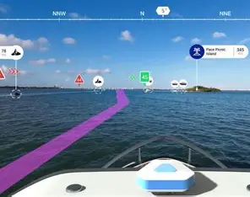
AI-Powered Safe Navigation System
Reimagining route guidance — prioritizing safety over speed.

Slide 2
Problem statement and its present day implications:
Today's navigation apps optimize for one thing: the shortest path. They ignore real-world safety — leaving users vulnerable.
Unsafe areas
High-crime zones and poorly lit areas are never factored into route calculations.
No realtime risk
Incidents, hazards, and emerging dangers are not reflected dynamically.
User safety ignored
Users may unknowingly travel through dangerous routes — with no warning.

Slide 3
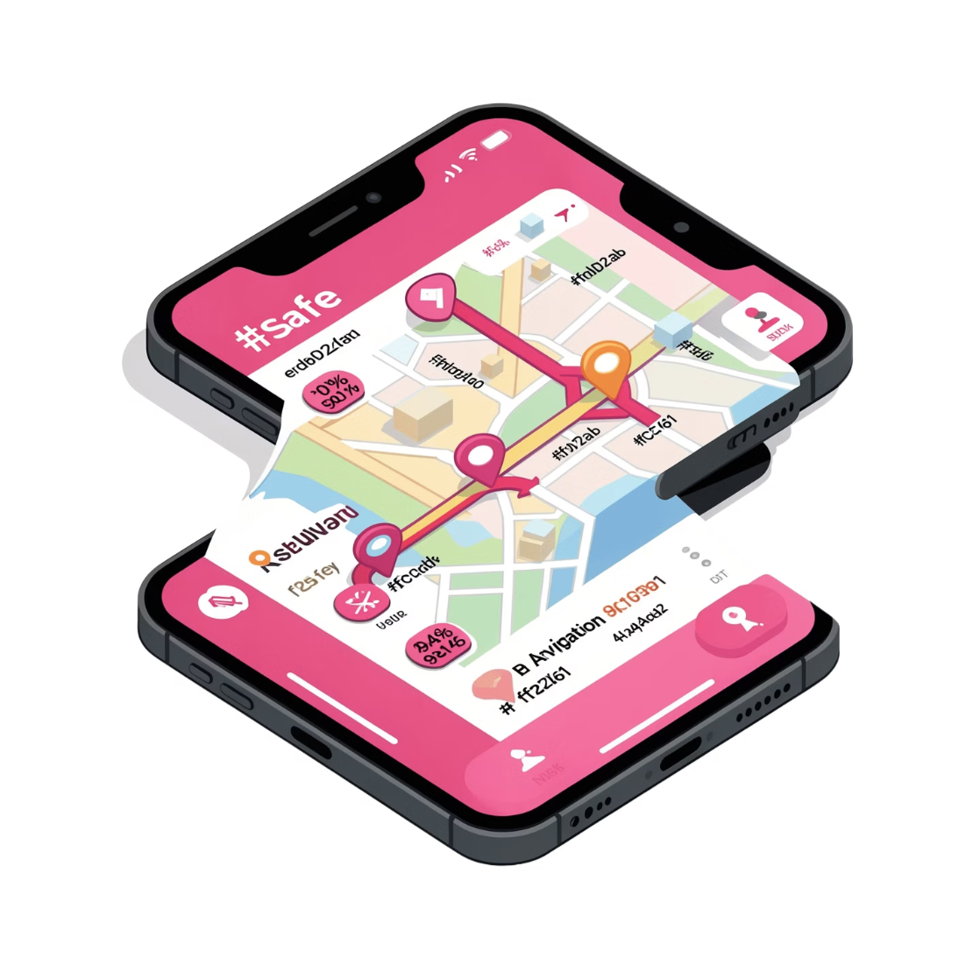
Proposed Solution
An AI-based navigation system that recommends the safest route — not just the shortest one. By combining real-time risk data, anomaly detection, and intelligent agent collaboration, it delivers navigation that actively protects users.
Risk-Aware
Intelligent Routing
Anomaly Detection
Identifies unusual patterns that may signal danger.
Integrates live and historical risk data into every route decision.
Multiple agents collaborate to select the optimal safe path.

Slide 4

System architechture
User Interface
Flask Backend
AI Agents
Database
The system uses a web-based interface with Leaflet maps, communicates via RESTful APIs, and stores risk data, alerts, and user reports in SQLite for persistent, real-time access.

Slide 5

🤖 Multi-Agent System
Four specialized AI agents collaborate to make intelligent, safety-first navigation decisions
Each agent has a distinct role in the pipeline
👥 Community Agent
Learns and updates area risk levels from user reports
🛡️ Guardian Agent
Detects anomalies in user behavior and environmental data
🧭 Route Agent
Evaluates and selects the safest available path
🚨 Emergency Agent
Triggers real-time alerts when critical danger is detected

Slide 6
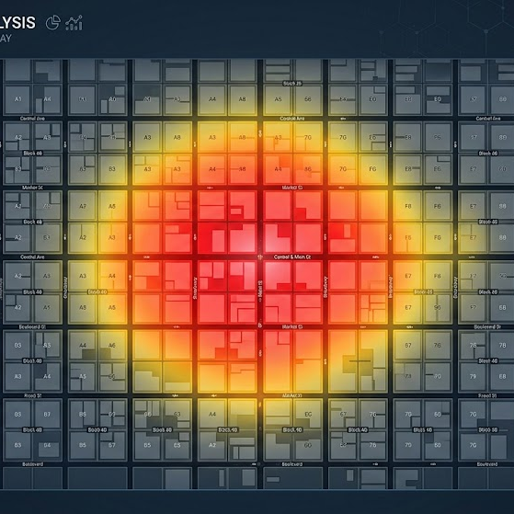
🤝 Community Agent – Risk Learning
📘 How Risk Is Learned
The system dynamically updates area risk scores
Based on three key mechanisms
Ensures the model stays current and responsive
🧾 User Reports
Crowd-sourced incident and safety reports
Feed directly into risk scores
⏳ Time Decay
Older reports lose influence over time
Keeps data relevant and up to date
🗺️ Spatial Smoothing
Risk propagates to nearby areas
Captures neighborhood-level pattern

Slide 7
Guardian Agent — Anomaly Detection
1)The Guardian Agent monitors real-time signals and applies weighted scoring to classify the current situation into one of three safety levels.
2)🟢 SAFE
Normal behavior
No risk indicators triggered
Continue navigation
🟡 WARNING
Moderate deviation or elevated risk detected
User is notified
🔴 DANGER
Critical anomaly or high-risk area
Emergency Agent is activated

Slide 8
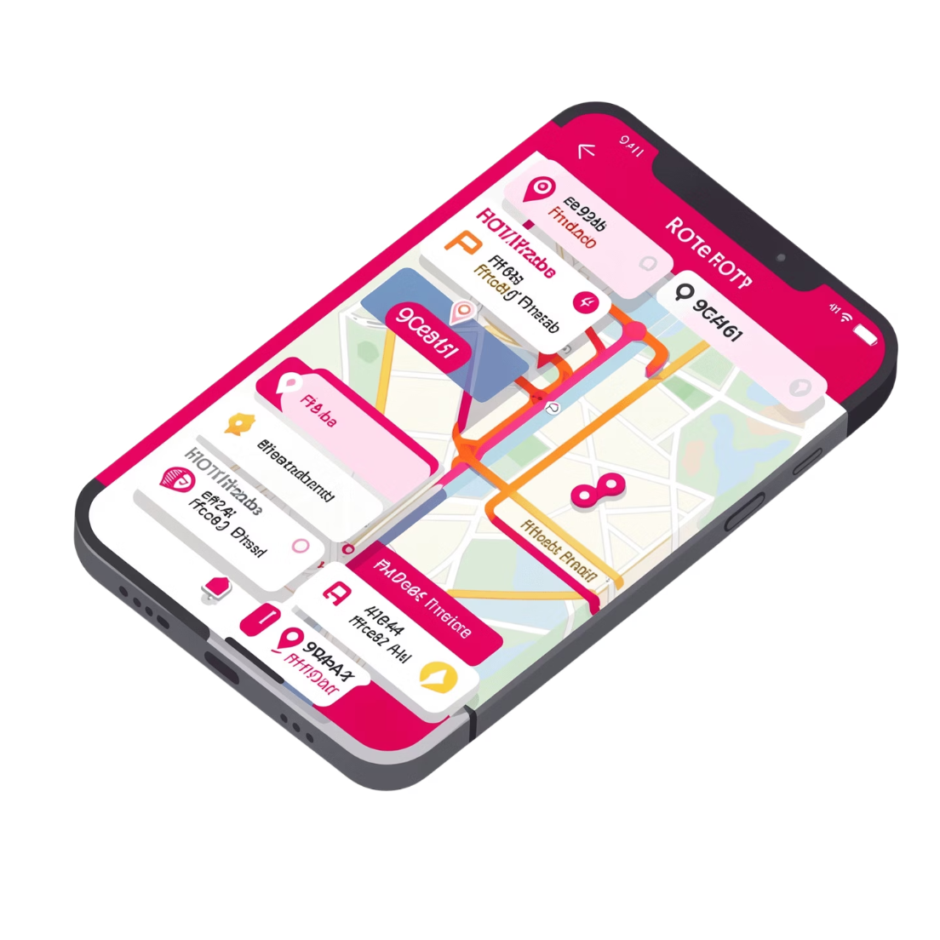
How the safe route is choosen
How the Safest Route Is Chosen
The Route Agent fetches multiple candidate routes and scores each using a composite formula:
Score = Risk Weight × Risk Score + Distance Weight × Distance Score
By balancing risk and distance, the system selects the safest viable route — not merely the shortest. Users retain the option to review alternatives.

Slide 9
Emergency Agent
When the Guardian Agent detects a DANGER state, the Emergency Agent immediately:
Triggers a real-time alert to the user
Logs the incident in the database
Supports rapid response workflows
Technology Stack
01. Flask
Lightweight Python backend orchestrating all API logic
02. SQLite
Persistent storage for risk data, alerts, and user reports
03. Google Maps API
Route fetching, geocoding, and map rendering

Slide 10
What the system achieves
Scalable Design
API-based architecture supports real-world deployment.
AI-Driven Safety
Multi-agent collaboration outperforms single-model approaches.
Future Roadmap
Live GPS tracking, ML prediction, mobile app, and real-time heatmaps.

